Slide 1
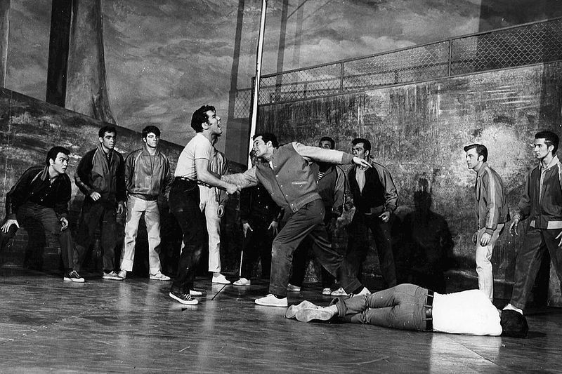
Rights Expression Languages Or, Copyright Law Rumbles with Technology in a Dark Alley
Bill Rosenblatt
GiantSteps Media Technology Strategies
January 8, 2019
Source: WikiMedia Commons, The Rumble from West Side Story, 1957

Slide 2
Background
Consultant with focus on digital media and copyright age since 2000
Background: software engineer, media industry IT executive, technology market strategist, author, editor, radio producer
Author: Digital Rights Management: Business and Technology (Wiley), copyrightandtechnology.com blog, journal articles, Forbes columnist, etc.
Chair of annual Copyright and Technology conferences
Speaker at World Economic Forum and other events worldwide
Guest lecturer at law, business, and music schools
Expert witness in copyright and patent litigation in US, Canada, Europe

Slide 3
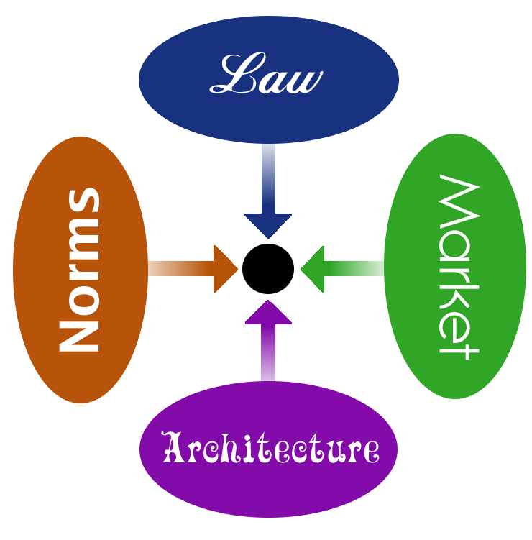
Larry Lessig’s Four Forces of Regulation (a/k/a Pathetic Dot Theory)
Source: Lessig, Lawrence, Code: And Other Laws of Cyberspace (1999), Ch. 7
Figure: http://libreria.sourceforge.net/library/Free_Culture/CHAPTER10.html

Slide 4
Copyright Law: The “Rights Bundle” (17 U.S.C. 101 et seq)
Applies to “material objects” (§ 101)
Not to files (piles of bits) independent of physical storage medium
Copyright owner’s exclusive rights (§ 106):
Reproduction
Distribution
Creation of derivative works
Public display
Public performance
Additional rights for certain visual works (§ 106A):
Proper attribution
Prevention of reputational harm by damage or mutilation of work
First sale a/k/a exhaustion (§ 109):
If you obtain it legally, you can dispose of it w/o involvement from publisher
(Doesn’t apply to most software)

Slide 5
Copyright Law: Ways for Others to Use Content
Use it personally
License rights from copyright owner (contract)
Fair use (§ 107)
A defense to allegation of infringement, not a “right”¹
Decided by courts, based on four factors
Examples in statute: criticism, education, research, news reporting
“Transformative use” theory from case law²
Not “machine decidable”³
¹Though see Lenz v Universal Music Corp, 801 F.3d 1126 (9th Cir. 2015).
²Leval, Pierre N., Toward a Fair Use Standard. 103 Harv. L. Rev. 1105 1989-1990
³”We should not adopt a bright-line standard unless it were a good one - and we do not have a good one.” Id.

Slide 6
Rights Expression Languages
Machine readable rights descriptions
Make rights and licenses understandable and actionable at Internet speed
Avoid “trap door into the legal system”¹
Two distinct, overlapping goals:
Enforce rights
Automate licensing
¹Author’s remarks at National Academies’ workshop on the Impact of Copyright Policy on Innovation in the Digital Era, October 15, 2010. Available at https://copyrightandtechnology.com/2010/10/17/my-remarks-at-the-national-academies/.

Slide 7
RELs for Rights Enforcement (DRM)
Mark Stefik’s mid-1990s work at Xerox PARC
Computer science researcher with AI background
Landmark paper: “Letting Loose the Light: Igniting Commerce in Electronic Publication” (1996)¹
U.S. Patent 5,715,403 (1998), “System for controlling the distribution and use of digital works having attached usage rights where the usage rights are defined by a usage rights grammar”
Original language: Digital Property Rights Language (DPRL)
Based on LISP
Xerox commercializes this as ContentGuard
¹Published as chapter in Stefik, Mark J. Internet Dreams: Archetypes, Myths, and Metaphors. 1996, MIT Press.

Slide 8
The “Establishment” REL: XrML (eXtensible Rights Markup Language)
1995-1998: Xerox
ContentGuard DRM system
One of several early DRMs
DPRL 2.0 released, based on XML
1999-2002: ContentGuard
Xerox spins out ContentGuard Inc., Microsoft part-owner
XrML released, expands DPRL 2.0
ContentGuard drops DRM product in 2002 to focus on patent licensing
2004-2005: Standards & Microsoft
XrML 2.0 submitted to MPEG
Variant becomes MPEG-REL standard
Microsoft implements XrML in its DRMs
Time Warner buys share of ContentGuard
ContentGuard granted US 6,925,448, continuation of ‘403 patent
2005-present: Virtual irrelevance
Microsoft uses XrML for software license management
No one else uses XrML or MPEG-REL
Pendrell, patent aggregator, buys ContentGuard

Slide 9
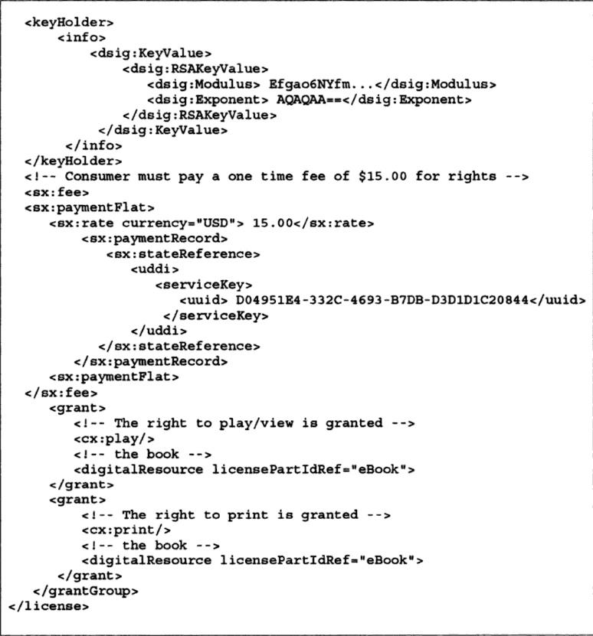
XrML Example Code
Source: Fernandez-Medina, Eduardo et al, Multimedia Security and Digital Rights Management Technology.
In Fugini, Mariagrazia and Carlo Bellettini, eds., Information Security: Policies and Actions in Modern Integrated Systems.
Hershey, PA: IDEA Group Publishing, 2004.

Slide 10
The “Indie” REL: ODRL (Open Digital Rights Language)
2000: V1.1 created by Renato Iannella in Australia
With help from Susanne Guth in Austria [not a typo]
Not tied to any companies or standards body
2001-2005:
Subsets used in Open Mobile Alliance DRM (OMA DRM) standards
Widely implemented in mobile digital music services in Europe
2006-2007
OMA DRM momentum dies on fears of “patent overhang” with ContentGuard and others
ODRL goes dormant …

Slide 11
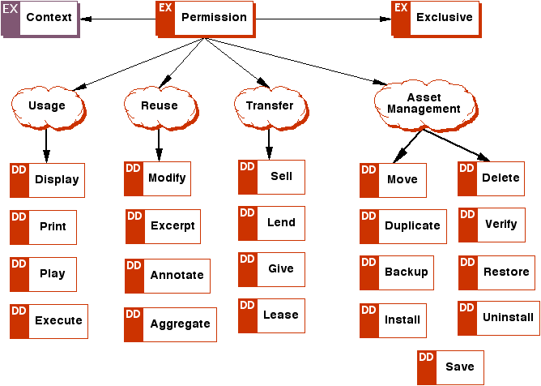
ODRL 1.1 Permission Model
Source: Open Digital Rights Language (ODRL) Version 1.1, W3C Note 19 September 2002, https://www.w3.org/TR/odrl/.

Slide 12
Other Enforcement-Oriented RELs
RealNetworks XMCL (eXtensible Media Commerce Language)
Used in RealNetworks Helix DRM for audio & video in mid-2000s
Abandoned as Microsoft and Apple dominated the market
Adobe EBX (Electronic Book eXchange)
Part of Adobe Content Server DRM for e-books
Acquired from Glassbook in 2000
Still used in Barnes & Noble Nook, OverDrive (library e-lending), and dozens of others worldwide today

Slide 13
RELs for License Automation
Machine-readable license terms
B-to-B distribution schemes
Enforcement (if any) done through legal means, not technological (DRM)
Original work: Henry Perritt, Villanova Law School
Law professor with engineering & business degrees from MIT
1993 paper: “Permission Headers and Contract Law”
Presented at seminal conference at Harvard Kennedy School¹
Information and Content Exchange (ICE), 1998
First attempt at standard, led by Vignette Corp. (now OpenText)
Oriented toward “content syndication”, dot-com bubble era fad
Made redundant by much simpler RSS
Faded after bubble burst
¹In Proc. Technological Strategies for Protecting Intellectual Property in the Networked Multimedia Environment, 1993. Available at https://www.cni.org/resources/historical-resources/technological-strategies-for- protecting-intellectual-property-in-the-networked-multimedia-environment

Slide 14
Interlude I: Creative Commons
Created in 2000-2001 by Larry Lessig et al, launched in 2002
Motto: “Some Rights Reserved”
Give licensee more rights than copyright bundle
Assume/pretend copyright bundle applies to piles of bits
Licenses = legal text + machine readable code in content files
Creators choose a license for content based on attributes:
Attribution: user must attribute work to author
Share alike: user must share content w/others on same terms
Non-commercial: no commercial uses allowed
No derivative works: content must be published “as is”

Slide 15
ccREL (Creative Commons Rights Expression Language)
Created by Hal Abelson of MIT in 2008
Make Creative Commons license terms more machine readable
Commercial use allowed or not?
Attribution to whom?
Syntax-independent
Expressible in RDF for XML content
Expressible in Adobe XMP for media files with headers
Meant to replace HTML comment syntax for CC
Increase machine-readability
Eliminate redundancy (DRY principle)
Not meant to turn CC into a DRM scheme

Slide 16
ccREL Example
<div xmlns:dc="http://purl.org/dc/elements/1.1/"
xmlns:cc="http://creativecommons.org/ns#"
xmlns:flickr="http://flickr.com/ns#"
about="http://www.flickr.com/photos/laughingsquid/2034629532/">
...
<h1 property="dc:title">NewTeeVee Live Game Show</h1>
...
<img rel="flickr:defaultPhoto"
src="http://farm3.static.flickr.com/2320/2034629532_02085434dd.jpg?v=0" />
...
<div property="dc:description">
See the blog post for more info:
<a href="http://laughingsquid.com/a-few-random-newteevee-live-photos/">
A Few Random NewTeeVee Live Photos
</a>
</div>
...
Source: Abelson, Hal et al, ccREL: The Creative Commons Rights Expression Language, 2008. Available at https://wiki.creativecommons.org/images/d/d6/Ccrel-1.0.pdf.

Slide 17
ccREL Example (cont’d)
This photo is licensed under a
<a rel="license" href="http://creativecommons.org/licenses/by-nc-nd/2.0/">
Creative Commons license
</a>.
If you use this photo within the terms of the license or make
special arrangements to use the photo, please list the photo credit as
<span property="cc:attributionName">Scott Beale / Laughing Squid</span>
and link the credit to
<a rel="cc:attributionURL" href="http://laughingsquid.com">
laughingsquid.com
</a>.
…
</div>
Source: Abelson, Hal et al, ccREL: The Creative Commons Rights Expression Language, 2008. Available at https://wiki.creativecommons.org/images/d/d6/Ccrel-1.0.pdf.

Slide 18
ODRL 2.x
ODRL reborn as license automation language!
Submitted to W3C in 2011, becomes Recommendation in early 2018
Multiple syntaxes
Various XML/RDF syntaxes, JSON
Addressing the patent overhang issue:
REL not used in DRM scheme
Core concepts of Permissions and Duties/Obligations
Manifestations:
W3C Permissions and Obligations Expressions (POE)¹
IPTC RightsML (ODRL profile) (news industry) ²
¹ https://www.w3.org/TR/2018/REC-odrl-model-20180215/ and https://www.w3.org/TR/2018/REC-odrl-vocab-20180215/.
² https://iptc.org/standards/rightsml/. See also https://www.slideshare.net/smyles/rights-for-photo-and-video-archives-at-the-associated-press.

Slide 19
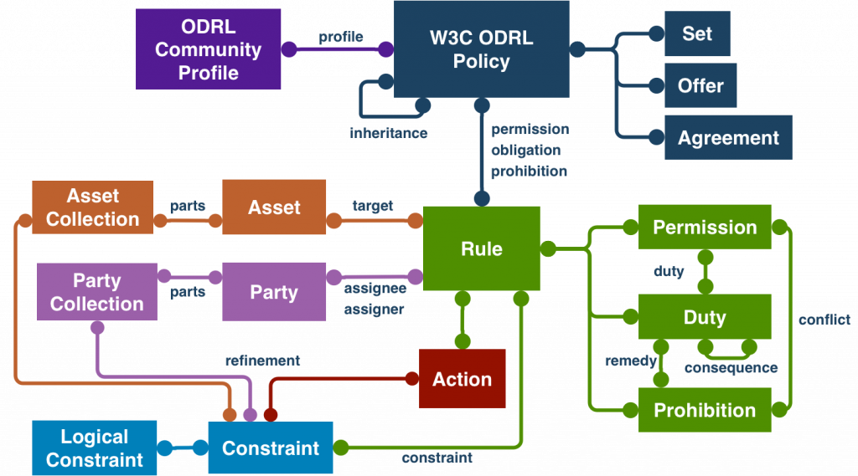
ODRL 2.2 Information Model
Source: Iannella, Renato, ODRL: A Path Well Traveled. Available at https://www.w3.org/blog/2018/02/odrl-a-path-well-travelled/.

Slide 20
ODRL 2.1 Examples Movie can only be played in Germany after 2018 (JSON)
{
"@context": "http://www.w3.org/ns/odrl.jsonld",
"@type": "Set",
"uid": "http://example.com/policy:1010",
"permission": [{
"target": "http://example.com/asset:9898.movie",
"action": "display",
"constraint": [{
"leftOperand": "dateTime",
"operator": "gt",
"rightOperand": { "@value": "2019-01-01", "@type": "xsd:date" }
}, {
"leftOperand": "spatial",
"operator": "eq",
"rightOperand": "https://www.wikidata.org/wiki/Q183",
"comment": "i.e Germany"
}]
}]
}
Source: https://w3c.github.io/odrl/bp/#styles

Slide 21
ODRL 2.1 Examples Allow distribution of movie over mobile networks only (JSON)
{
"@context": "http://www.w3.org/ns/odrl.jsonld",
"@type": "Set",
"uid": "http://example.com/policy:6161",
"permission": [{
"target": "http://example.com/asset:9898.movie",
"assigner": "http://example.com/org:616",
"action": [{
"action": "distribute",
"refinement": [{
"leftOperand": "deliveryChannel",
"operator": "eq",
"rightOperand": "http://example.com/cv/audMedia/MOBILE"
}]
}]
}]
}
Source: https://w3c.github.io/odrl/bp/#styles

Slide 22
RightsML Example Picture can be displayed by EPA licensee within Germany (RightsML Data Structure template)
Policy:
type: "http://www.w3.org/ns/odrl/2/Set"
uid: "http://example.com/RightsML/policy/idGeog1"
profile: "https://iptc.org/std/RightsML/odrl-profile/"
permission:
- target: "urn:newsml:example.com:20120101:180106-999-000013"
assigner: "http://example.com/cv/party/epa"
assignee:
type: "http://www.w3.org/ns/odrl/2/PartyCollection"
uid: "http://example.com/cv/partygroup/epapartners"
action: "http://www.w3.org/ns/odrl/2/distribute"
constraint:
- leftOperand: "http://www.w3.org/ns/odrl/2/spatial"
operator: "http://www.w3.org/ns/odrl/2/eq"
rightOperand: "http://cvx.iptc.org/iso3166-1a3/DEU"
Source: http://dev.iptc.org/RightsML-Simple-Example-Geographic

Slide 23
RightsML Example The same code in JSON
{
"@context": ["http://www.w3.org/ns/odrl.jsonld",
"https://iptc.org/std/RightsML/odrl-profile/rightsml.jsonld"],
"@type": "Set",
"uid": "http://example.com/RightsML/policy/idGeog1",
"profile": "https://iptc.org/std/RightsML/odrl-profile/",
"permission": [{
"target": "urn:newsml:example.com:20120101:180106-999-000013",
"assigner": "http://example.com/cv/party/epa",
"assignee": {
"@type": "PartyCollection",
"uid": "http://example.com/cv/partygroup/epapartners" },
"action": "distribute",
"constraint": [{
"leftOperand": "spatial",
"operator": "eq",
"rightOperand": "http://cvx.iptc.org/iso3166-1a3/DEU"
}]
}]
}

Slide 24
Other License Automation RELs
PLUS (images)¹
PRISM Rights Language (magazine publishing)²
METSRights (gov’t & academic libraries)³
ONIX-PL (books)⁴
¹ http://www.useplus.com/index.asp.
² http://www.prismstandard.org/specifications/3.0/PRISM_usage_rights_metadata_3.0.pdf.
³ https://www.loc.gov/standards/rights/.
⁴ https://www.editeur.org/21/ONIX-PL/.

Slide 25
RELs, DRMs, Licenses, and Copyright
Licenses: legally enforced rights & restrictions
DRM: technologically enforced rights & restrictions
RELs enable precision for both
RELs can encode licenses that confer more rights than copyright (basic idea of Creative Commons)
… or licenses that confer less rights than copyright (true of most EULAs)
Relevant point of law: You don’t get the copyright bundle with pure digital content.¹
Relevant point of technology: RELS don’t make DRM capable of emulating copyright rights accurately.
¹ Capitol Records, LLC v. ReDigi Inc., No. 16-2321 (2d Cir. 2018)

Slide 26
The Digital Media Project An attempt to make a DRM that emulates copyright accurately
Dr. Leonardo Chiariglione, founder of MPEG standards body
Attempt to create open interoperable DRM standards that respect and emulate real-world content usages, incl. copyright
Started in 2003
On “low simmer” since ~2007
Mappings of “Traditional Rights and Usages” to REL expressions
Promising work, never completed

Slide 27
Interlude II: Music Rights and Services (Typical cases)
All music recordings carry two copyrights:
One for the composition a/k/a musical work
One for the sound recording
Subscription digital music services (DSPs) typically offer:
Interactive streams (user chooses each track)
Conditional a/k/a tethered downloads (plays until subscription cancelled)
Permanent downloads (users pay extra)
Subscription DSPs must pay these royalties:
Reproduction & distribution of sound recording: to record label
Reproduction & distribution (“mechanical”) of composition: to music publisher (compulsory under § 115)
Public performance of composition: to PRO (ASCAP, BMI, SESAC, GMR) or direct to music publisher

Slide 28
The Music Modernization Act Revisions to § 115
§ 115: compulsory license for composition mechanicals
Replaces track-by-track with blanket license
Solves “matching problem”:
DSPs take in >10,000 tracks/day
They must find compositions underlying sound recordings
And issue license paperwork for each, or risk infringement actions
Old, incorrect, missing, disputed data makes this a huge burden
Spotify and Apple have been sued over this
Creates single agency to process all these mechanicals
Instead of each DSP doing this itself (or hiring 3rd party agency)

Slide 29
Representing MMA License in a REL
Rights publisher grants to DSP:
Blanket statutory mechanical license, no need to get it for each track
(Performance license not affected, though royalty rate may change)
DDEX: music industry messaging standard
Used by many labels & indie aggregators for metadata sent with music to DSPs
Codes for rights granted (distribution channels), e.g.:
OnDemandStream
Conditional-Download
PermanentDownload

Slide 30
Representing MMA License in a REL?
User
Device 1
…
Publisher
DSP
User
Device N
Track: 97432428
Format: MP3 320kbps
Rights:
OnDemandStream
PermanentDownload
Conditional-Download
Track: 97432428
Format: MP3 320kbps
Rights:
OnDemandStream
Download and play until end of month

Slide 31
Exercise: Represent MMA Rights in REL
As RightsML style data structure
Extra credit: in ODRL JSON or RDF syntax
Extra extra credit: represent all rights for interactive music DSPs as ODRL profile
Stream, conditional download, permanent download
Composition and sound recording rights

Slide 32
Thank You!
Bill Rosenblatt
GiantSteps Media Technology Strategies
billr@giantstepsmts.com
Blog: https://copyrightandtechnology.com/
Twitter: @copyrightandtec
LinkedIn: https://www.linkedin.com/in/billrosenblatt/

